Slide 1

Herm0ni Chess Bot Seán Rourke C00251168
(Vecteezy, n.d.)
Final Year Project Presentation

Slide 2
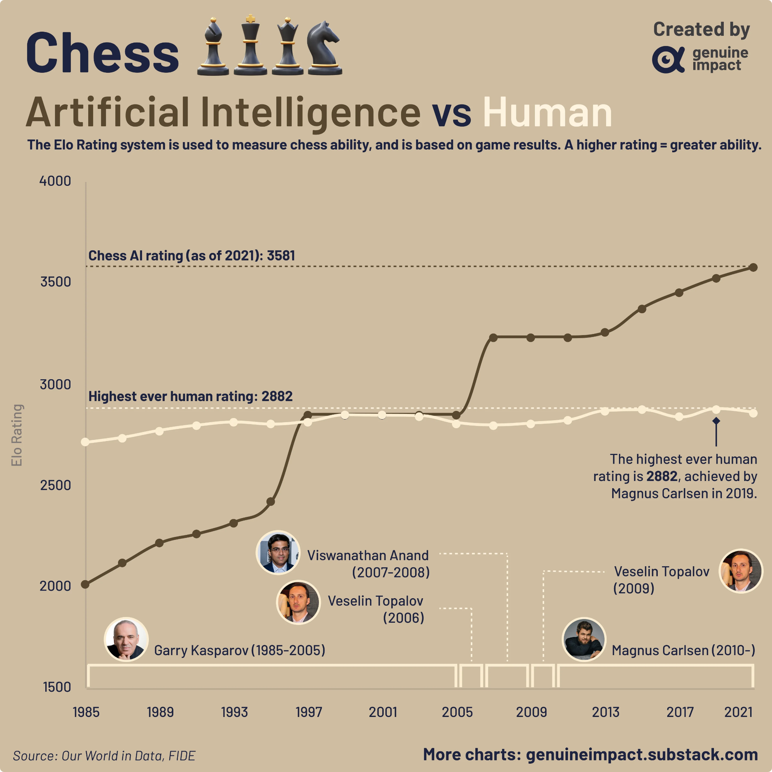

AI in Chess First implemented in as early as 1912 First fully automated engine created in 1957 Surpassed human ability in 1997 Current estimated Elo of 3642 Highest human Elo is 2882
Ai and Human Elo over time (Genuine Impact, 2023)

Slide 3


Practicing with AI
Over 100 different bots on Chess.com
Vast majority require a paid subscription
Large skill gaps between free bots

Slide 4



The Herm0ni Bot
Multiple levels of difficulty
Free to play on lichess.org
Play against users for fun or practice
Play against other bots
Artificial Intelligence and Chess: An Evolving Landscape
(Deverell, 2023)

Slide 5
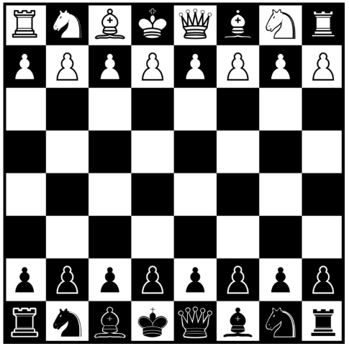

Design
Track positions using bitboards
Calculate moves using minimax algorithm with alpha-beta pruning
Evaluate position with heuristic algorithm
Implement Lichess Bot API

Slide 6
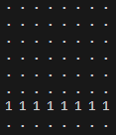
Bitboards
bitboards[PAWN][WHITE] = 0x000000000000FF00;
64-bit hexadecimal number
1 bit represents the presence of a piece
Used in conjunction with piece array
Bitboard per piece per colour
Bitboard for all pieces, all white pieces and all black pieces
allPieces = whitePieces | blackPieces;
Bitboard representation of white pawns

Slide 7

Heuristic Algorithm Determine the evaluation of the position based on:
Material Count
Piece Activity
King Safety
Pawn Structure
Centre Control
Piece Coordination

Slide 8
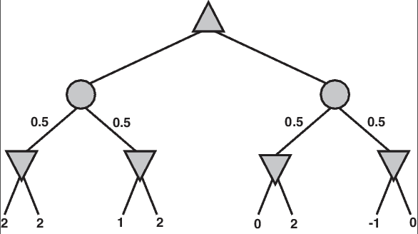
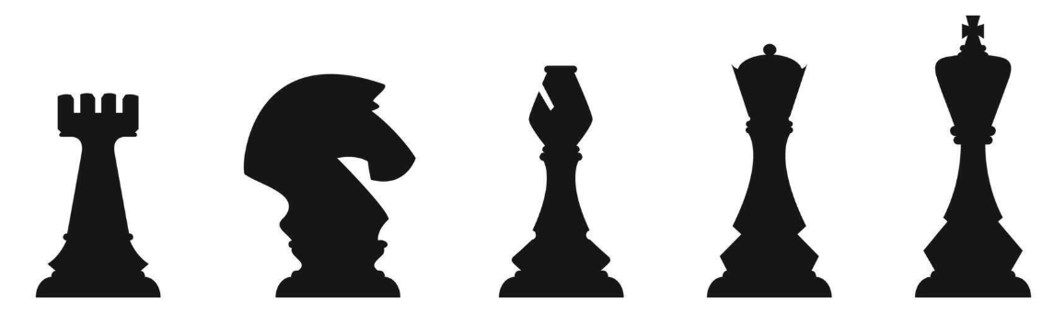
Alpha Beta Search
Uses Alpha and Beta values – best values each player guarantee.
Simulates potential moves for current player.
Evaluate resulting position using heuristic.
Assume opponent makes the best move.
Prune branches that cannot affect the final decision.

Slide 9



Technologies C++ Lichess Bot API (Python) JSON (UCI) Hosting Platform

Slide 10


Additional Features Use of opening books Use of endgame tablebases

Slide 11
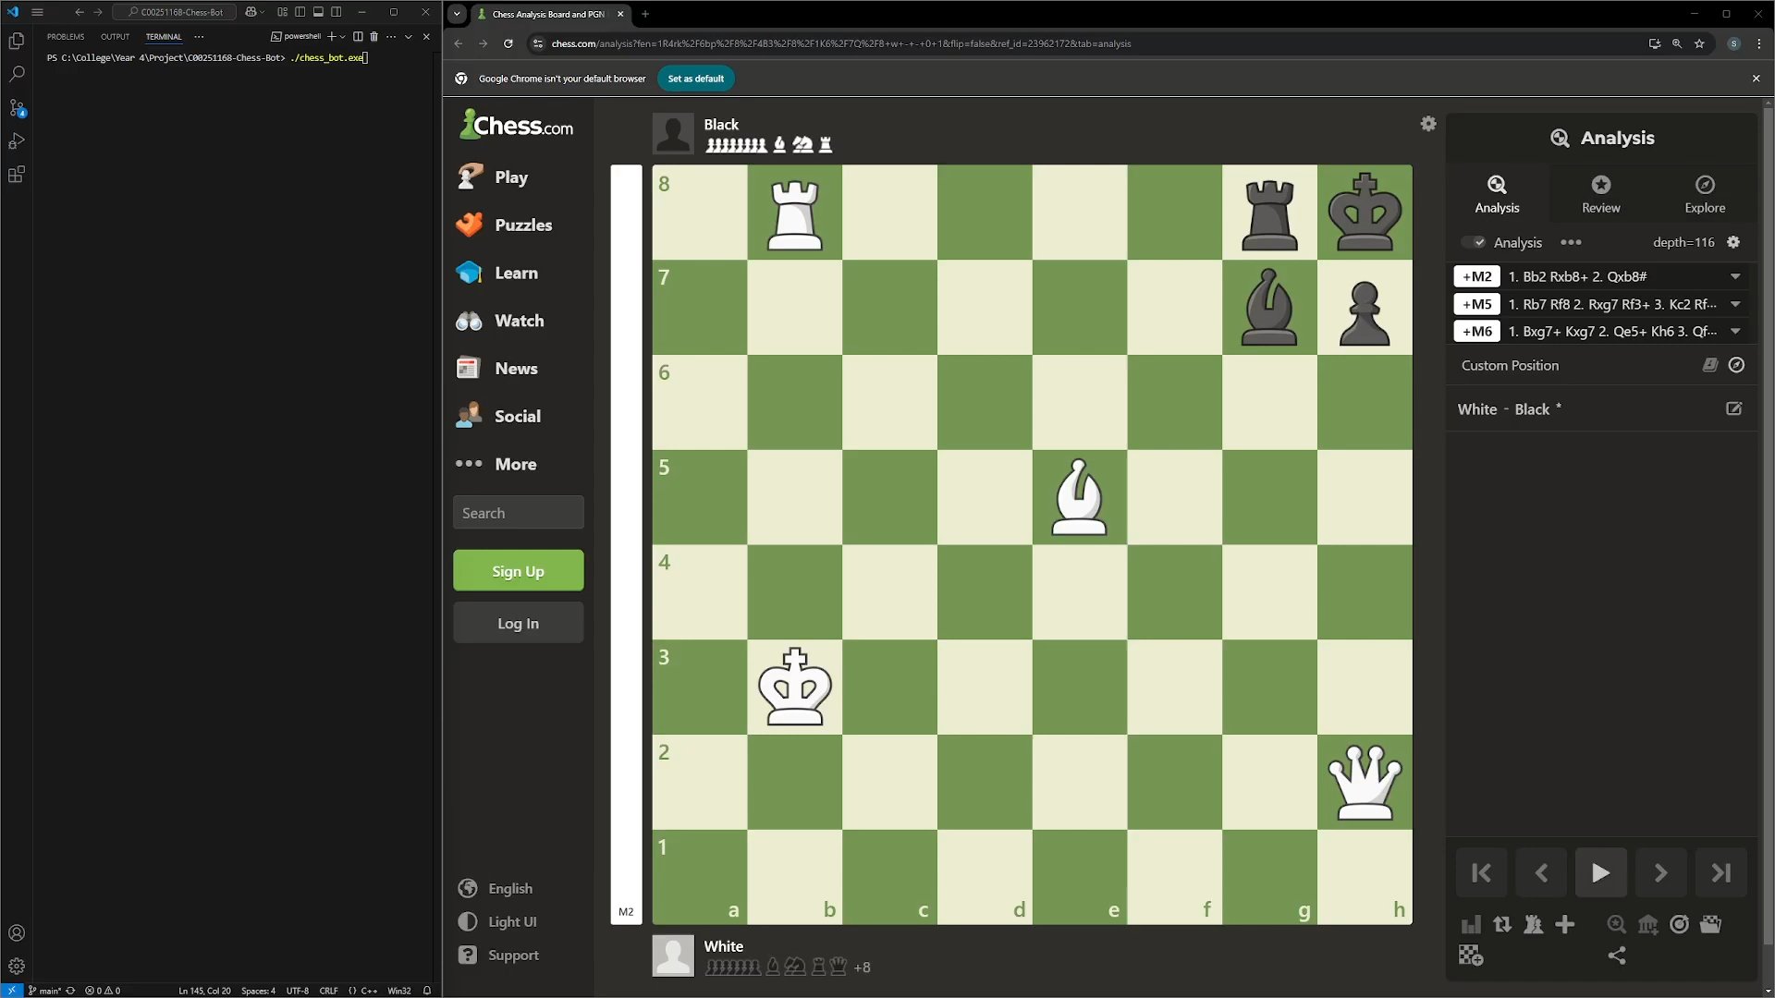

Slide 12


Questions

Slide 13
References
Deverell, J., 2023. Artificial Intelligence and Chess: An Evolving Landscape. [Online] Available at: https://www.regencychess.com/blog/artificial-intelligence-and-chess-an-evolving-landscape/ [Accessed: 24/10/2024].
Genuine Impact (2022). AI vs human chess Elo ratings over time. Available at: https://www.reddit.com/r/dataisbeautiful/comments/113mll8/oc_ai_vs_human_chess_elo_ratings_over_time/ (Accessed 20/10/2024).
Vecteezy, n.d. Vecteezy. [Online] Available at: https://www.vecteezy.com/free-vector/chess-silhouette [Accessed 24 November 2024].

